Slide 1

Global Governments’
Spending Analysis
Team 5
Brett Fuller, Diego Jones, Mav Sanchez

Slide 2
Motivation & Summary
We thought it would be interesting to compare the fiscal spending of the top 50 developed countries in the world. We wanted to analyze how each country breaks up their spending, and see if the amount they spend and allocate in a sector correlates with any higher Human Development Indicators.
Notes:
Describe the questions you asked, and why you asked them - Each of us come up with reasons for why we chose our topics.
Describe whether you were able to answer these questions to your satisfaction, and briefly summarize your findings - Each of us go in order talking about our topics, and briefly state if we found a correlation or not.

Slide 3
Our Questions
We are interested exploring the following areas:
Is there a correlation between country budget and overall worldwide ranking?
What are the top priorities in terms of spending of advanced countries?
Is there a correlation between health budget allocation vs citizen life expectancy?
What is the correlation between global safety ranking and percentage of spending on safety?
Is there a correlation between education budget allocation versus students’ academic performance?
What is the correlation between environment spend and CO2 emission?
Is there a relationship between budget on social protection vs gender equality index?
Notes:
Elaborate on the questions you asked, describing what kinds of data you needed to answer them, and where you found it - note your data sources after your questions

Slide 4
Global Ranking
Is there a correlation between what countries spend their money on and having a “better” country?
Notes:
Elaborate on the questions you asked, describing what kinds of data you needed to answer them, and where you found it - note your data sources after your questions

Slide 5
Categories Used by US News
Adventure (2%): friendly, fun, pleasant climate, scenic, sexy.
Citizenship (15.88%): cares about human rights, cares about the environment, gender equality, progressive, religious freedom, respects property rights, trustworthy, well-distributed political power.
Cultural Influence (12.96%): culturally significant in terms of entertainment, fashionable, happy, has an influential culture, modern, prestigious, trendy.
Entrepreneurship (17.87%): connected to the rest of the world, educated population, entrepreneurial, innovative, provides easy access to capital, skilled labor force, technological expertise, transparent business practices, well-developed infrastructure, well-developed legal framework.
Heritage (1.13%): culturally accessible, has a rich history, has great food, many cultural attractions.
Movers (14.36%): different, distinctive, dynamic, unique.
Open for Business (11.08%): bureaucratic, cheap manufacturing costs, corrupt, favorable tax environment, transparent government practices.
Power (7.95%): a leader, economically influential, politically influential, strong international alliances, and a strong military.
Quality of Life (16.77%): a good job market, affordable, economically stable, family friendly, income equality, politically stable, safe, well-developed public education system, well-developed public health system.

Slide 6
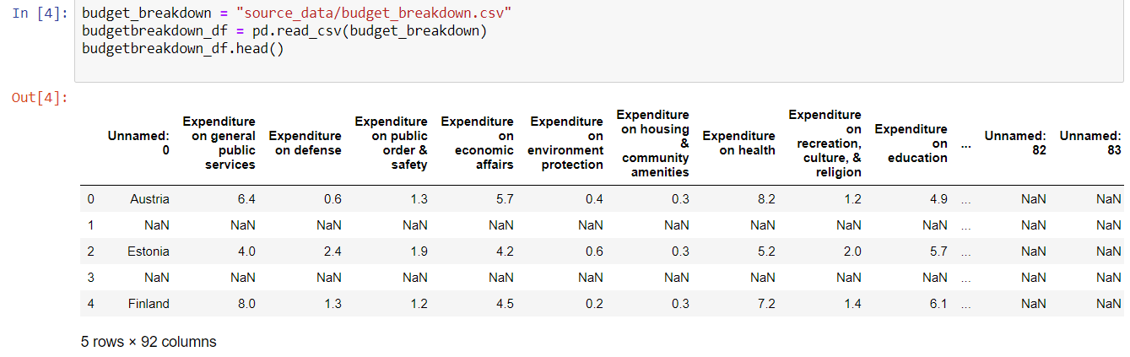
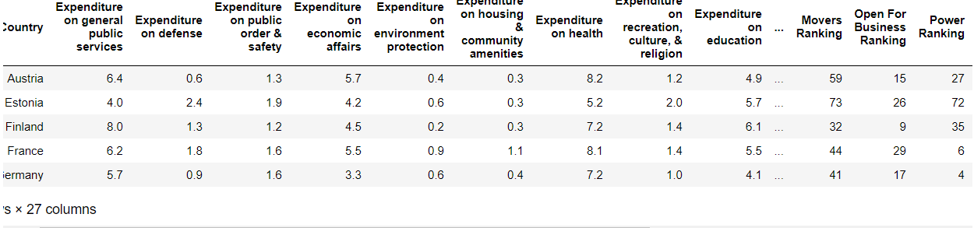
Data Cleaning
I began with 3 separate CSVs, one containing the US News County Rankings, another containing the budget breakdowns of various countries and a third including Statistic data such as population literacy rate and GDP. The budget breakdown data came from the International Monetary Fund Website and the population statistics came from the website Data.World
I combined this CSV along with the Statistic Data and Budget Breakdown in order to have one CSV with a list of all the Countries, budget breakdown and various rankings and population data. Unfortunately, I was only able to collect data on 38 of the top 50 countries

Slide 7
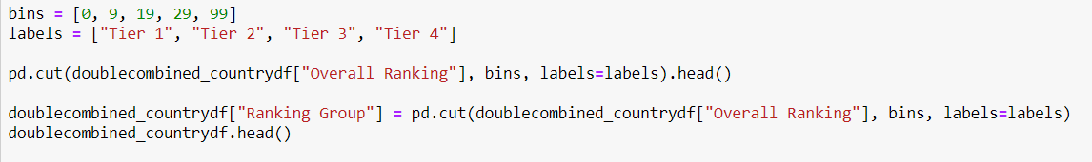
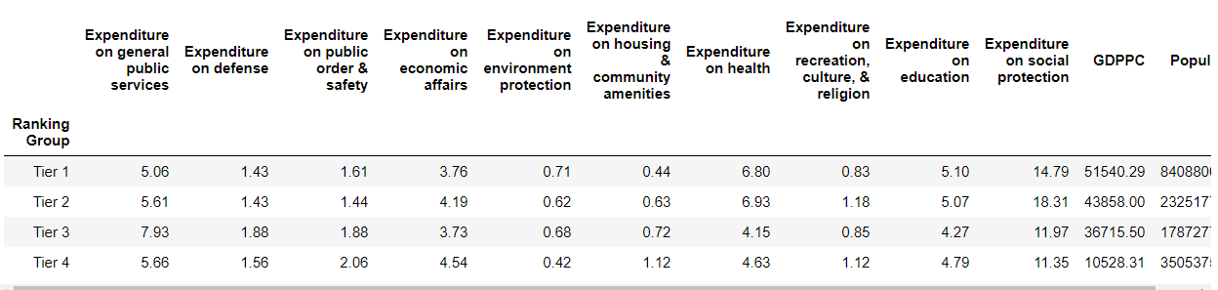
Data Cleaning continued
Placed the countries into bins based on their overall ranking

Slide 8
Analysis
It is difficult to say which country is the “Best,” this is by nature a very abstract and open ended question.
For the purposes of this analysis, we settled on using the US News Best Countries of 2016 Rankings, which assigned each country in the top 65 a ranking based on several categories, Entrepreneurship Adventure Citizenship Cultural Influence Heritage Movers Open for Business Power Quality of Life
Each of these was assigned a weighted value according to what they viewed was important to the success of a modern nation, and summed to provide the overall ranking

Slide 9
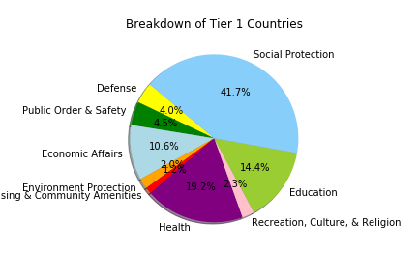
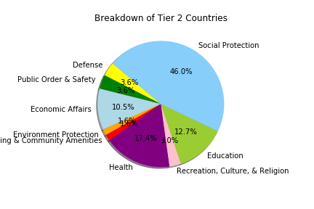
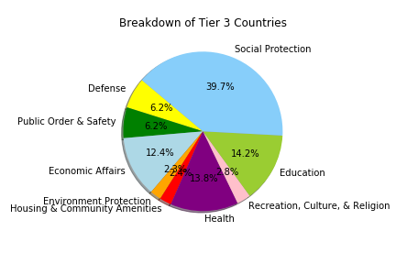
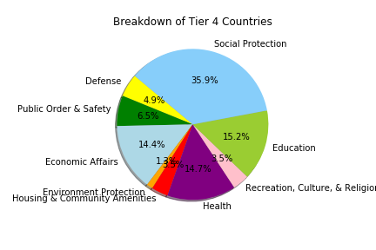
Data Analysis
Comparison of each of the tiers of country by budget categories

Slide 10
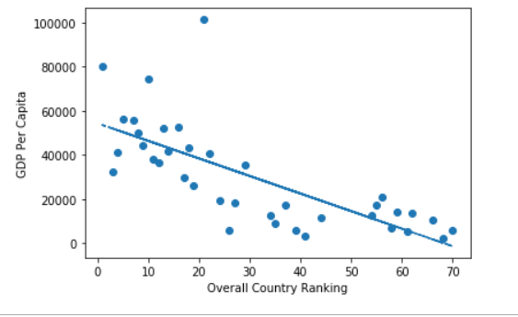
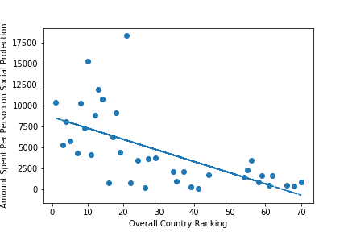
Notes:
The correlation between GDP and ranking is -0.73
the correlation between social protection and ranking is -0.63

Slide 11

Safety
What is the correlation between global safety ranking and percentage spent on safety?

Slide 12
Safety
What is the correlation between global safety ranking and percentage spent on safety?

Slide 13
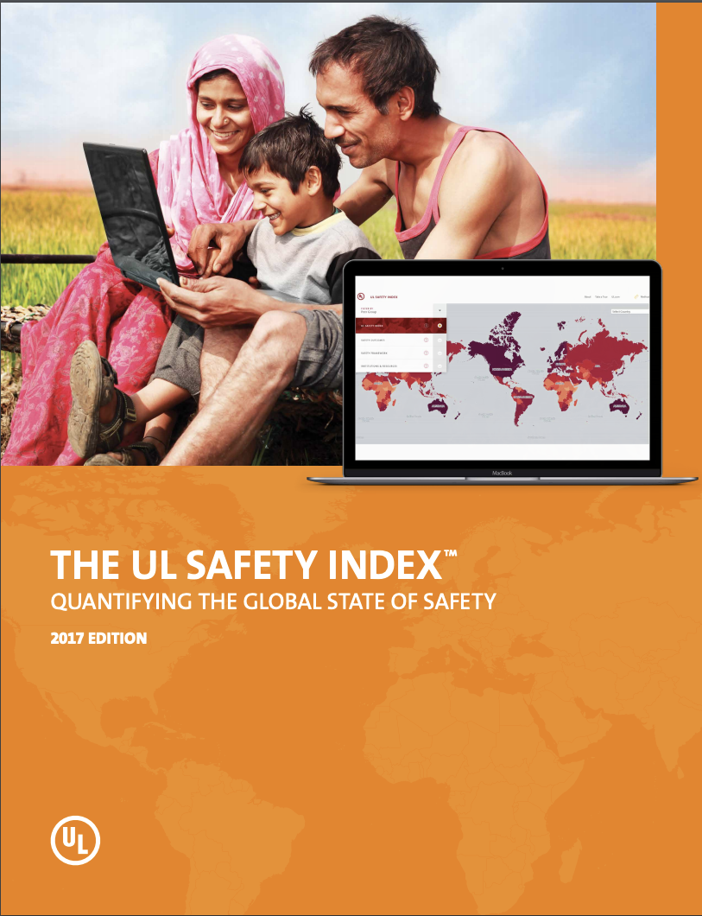
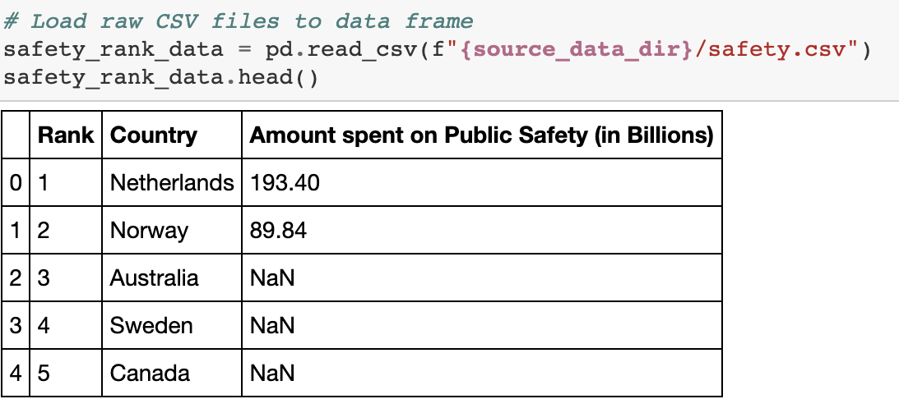
Data Cleanup & Exploration
Source:
Underwriters Laboratories Inc. (2017), “The UL Safety Index: Quantifying the Global State of Safety 2017 Edition”, ULSafetyIndex.org.
Notes:
Using the 2017 edition of the UL Safety Index, I was able to copy the safest country rankings to a csv file and open it in jupyter notebook. Because the dataset was in pdf form, I had to manually make my own csv file.

Slide 14
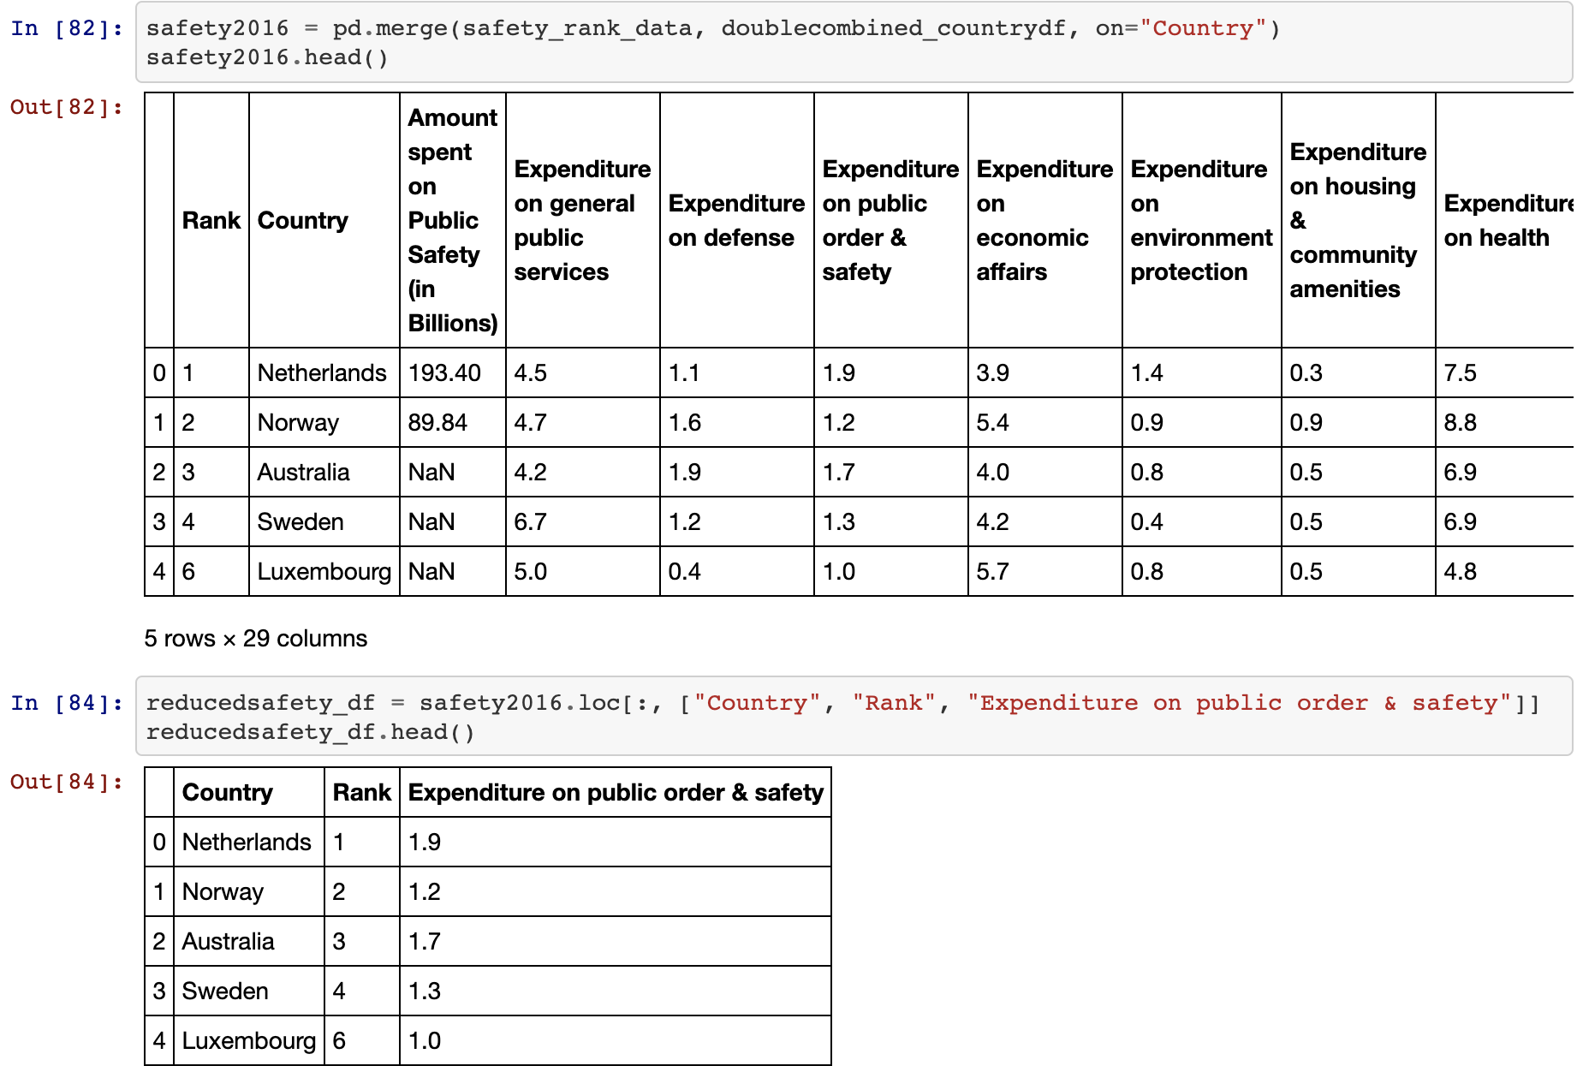
Data Cleanup & Exploration
Notes:
I then merged my csv file with Diego’s combined_countrydf to make my data frame.

Slide 15
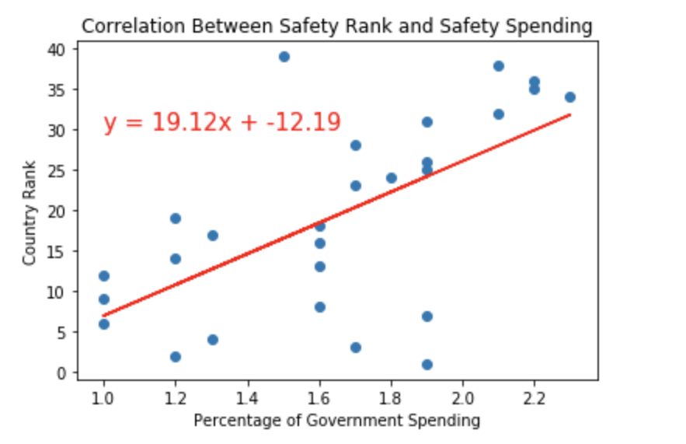
Data Analysis
Safety Ranking vs Safety Spending
The plot below shows a negative correlation between the percentage of a country's expenditure on public safety and it's global safety ranking.
Notes:
The plot shows a negative correlation between the percentage of a country's expenditure on public safety and it's global safety ranking. The r-value of .61 means this is a moderately strong correlation. The opposite of what I thought would happen was actually displayed - the lower a country was ranked on the UL Public Safety Index, - countries such as Lithuania, Turkey, Croatia, and Poland - the higher the percentage of it's safety spending. We are ranked 20th in the Safety Index, and spend about 2.0% on public safety. So we are a slight outlier for this.

Slide 16
Data Limitations
Social and economic factors could be hidden variables at play, as well as the size of the country’s population
Data was for 2016 only, so cannot see what has changed
Notes:
Most of the top 20 countries are all in Western Europe, have stronger/more free economies, more developed -
already a nicer place to live, they don’t have to put as much spending into public safety as other less developed countries

Slide 17

Health
Is there a correlation between health budget allocation vs citizen life expectancy?

Slide 18
Health
Is there a correlation between health budget allocation and citizen life expectancy?

Slide 19
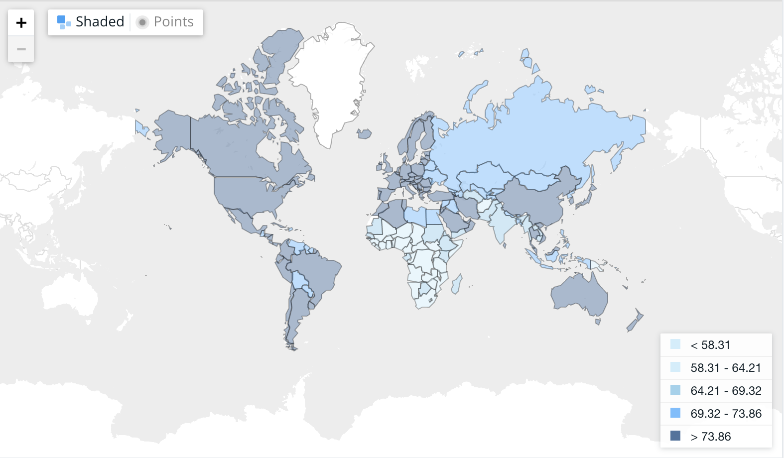
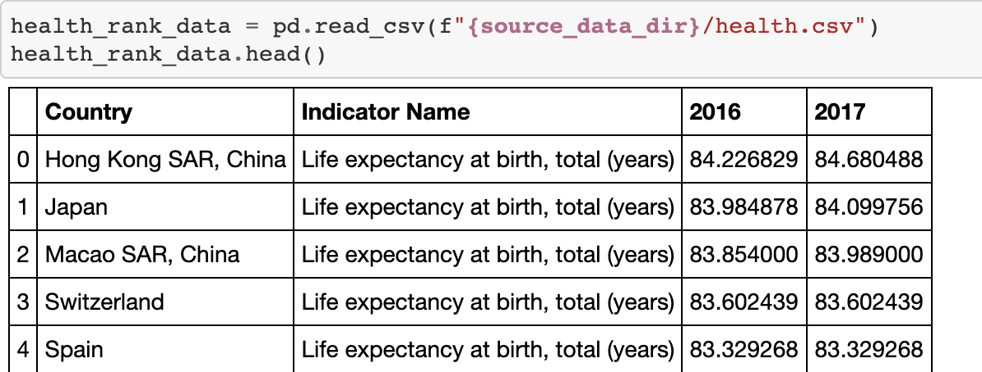
Data Cleanup & Exploration
Source:
The World Bank
“Life expectancy at birth, total (years)”
Notes:
As you can see, countries in dark blue have a higher life expectancy than light blue countries.
Downloaded data from the world Bank website and imported it into pandas.

Slide 20
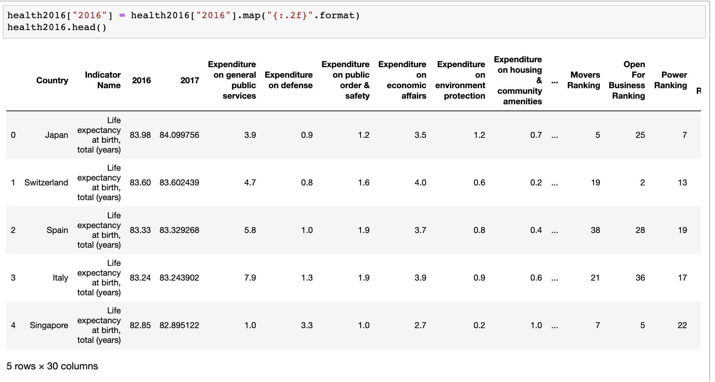
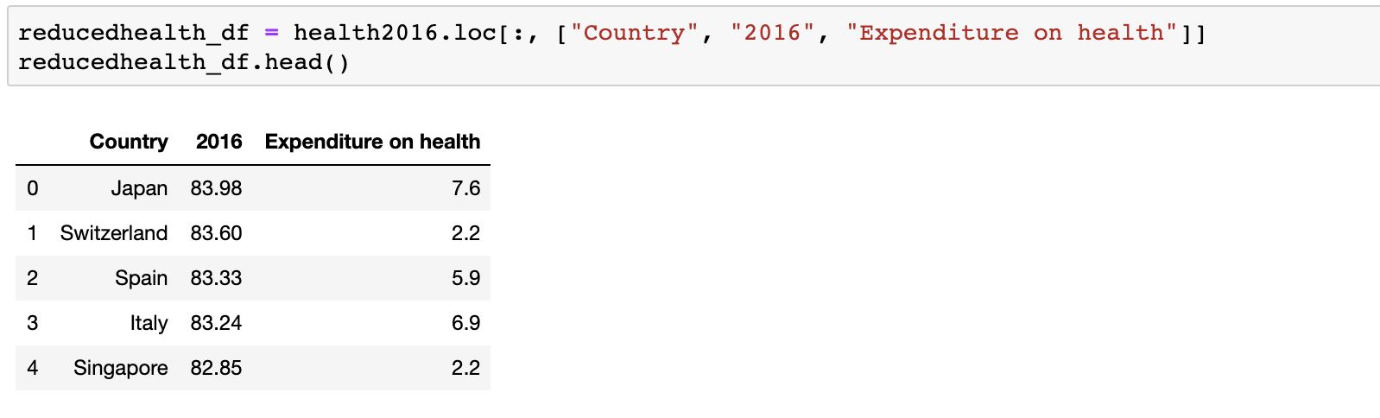
Data Cleanup & Exploration
Notes:
I then merged my csv file with Diego’s combined_countrydf to make my data frame.

Slide 21
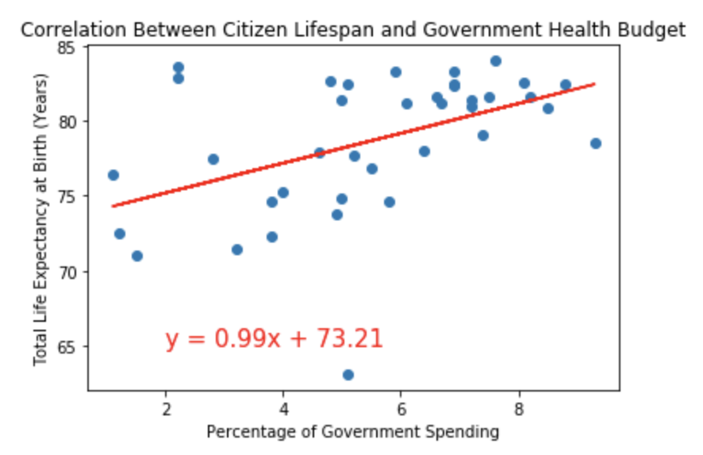
Data Analysis
Life Expectancy vs Health Spending
The plot below shows a moderately positive correlation between the percentage a country spends on healthcare and the life expectancy of its citizens.
Notes:
The plot shows a moderately positive correlation between the percentage of a countries' expenditure on healthcare and the total life expectancy of its citizens. The r-value is only 0.47, showing that the correlation is on the weaker side. From the data we can determine that citizens in countries with higher GDP expenses allocated to healthcare tend to live longer. One outlier of this would be the United States - we were ranked 53rd in the world with a life expectancy of 78.54, but we spend the most on healthcare out of any developed country 9.3% going to

Slide 22
Data Limitations
What was included in health spending varied from country to country - could be a confounding variable
Data was for 2016 only, so no multi-year analysis

Slide 23

Education
What is the government’s education budget allocation effect on students' academic performance?
Notes:
Elaborate on the questions you asked, describing what kinds of data you needed to answer them, and where you found it - note your data sources after your questions

Slide 24
Education
What is the government’s education budget allocation effect on students' academic performance?
Notes:
Elaborate on the questions you asked, describing what kinds of data you needed to answer them, and where you found it - note your data sources after your questions

Slide 25
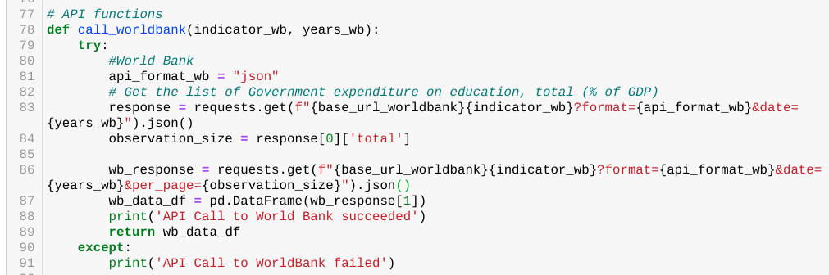
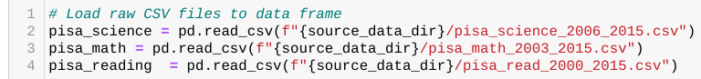
Data Cleanup & Exploration
Sources and method:
World Bank Government expenditure on education, total (% of GDP)
API Call to World Bank, no credentials needed
OECD Programme for International Student Assessment Result
CSV for Math, Science and Reading
2006 to 2015

Slide 26
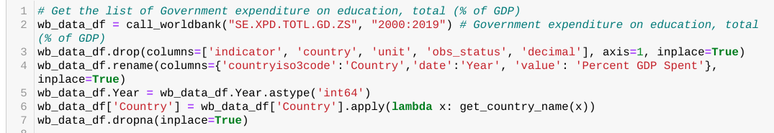
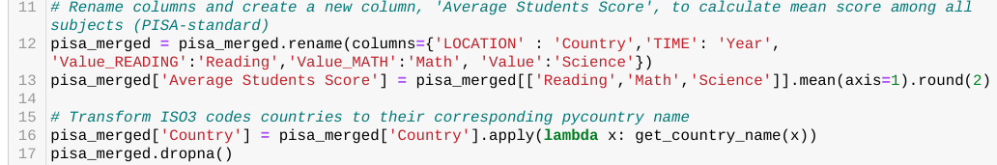
Data Cleanup & Exploration
Transformation:
World Bank Government expenditure on education, total (% of GDP)
Slice to only needed columns
Minor data formatting
OECD Programme for International Student Assessment Result
Pull only 2006 data onwards
Merge all subjects
Standardize Country name
Perform mean score for all subjects

Slide 27
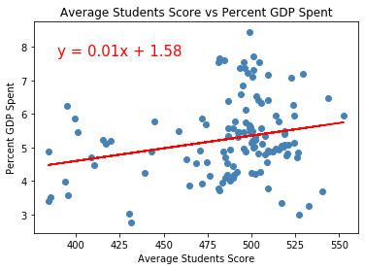
Data Analysis
Students’ Performance vs Percent GDP
The plot below shows a positive correlation between countries' expenditure on education on all levels and the students' performance on OECD Programme for International Student Assessment.
Notes:
The plot below shows a positive correlation between countries' expenditure on education on all levels and the students' performance on OECD Programme for International Student Assessment. The r-value between the correlation is 0.24. Countries with higher GDP expense allocated to education tends to score higher on Reading, Math, and Science. With the data set pulled from United Nations and World bank ranging from 2000 to 2019, it can be said that there is a causal relationship between education spending and students' performance.

Slide 28
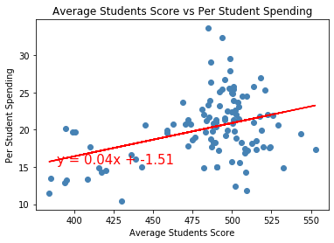
Data Analysis
Students’ Performance vs Per Student Spending
Although national GDP varies country to country and depends on economic standings, we pulled the GDP Per Capita (GDP % Population) and also saw a positive correlation between the mean students' score and GDP Per Student spending.
Notes:
Although national GDP varies country to country and depends on economic standings, we pulled the GDP Per Capita (GDP % Population) and also saw a positive correlation between the mean students' score and GDP Per Student spending. Note that the OECD Data of "per student spending" is the 'average general government expenditure (current, capital, and transfers) per student in the given level of education, expressed as a percentage of GDP per capita.'. The r-squared (absolute) is :0.3672940012232876

Slide 29
Data Limitations
PISA data tested only secondary school students 15 years
Spending to Testing year alignment can also be calculated by getting previous year’s spending (further causation analysis)

Slide 30
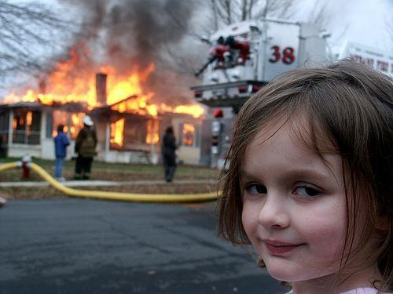
Climate Change
What are the possible Government Expenses that can be linked to CO2 emissions?
Notes:
Elaborate on the questions you asked, describing what kinds of data you needed to answer them, and where you found it - note your data sources after your questions

Slide 31
Climate Change
What are the possible Government Expenses that can be linked to CO2 emissions?
Notes:
Elaborate on the questions you asked, describing what kinds of data you needed to answer them, and where you found it - note your data sources after your questions

Slide 32
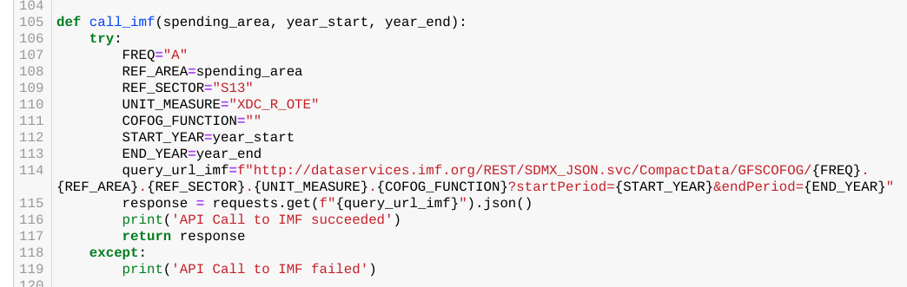
Data Cleanup & Exploration
Sources and method:
World Bank Total Greenhouse Gas Emissions
API, no authentication
IMF API Government Finance Statistics (GFS), Expenditure by Function of Government (COFOG)
API, no authentication
Notes:
WorldBank Total greenhouse gas emissions in kt of CO2 equivalent are composed of CO2 totals excluding short-cycle biomass burning (such as agricultural waste burning and Savannah burning) but including other biomass burning (such as forest fires, post-burn decay, peat fires and decay of drained peatlands), all anthropogenic CH4 sources, N2O sources and F-gases (HFCs, PFCs and SF6).
IMF API Government Finance Statistics (GFS), Expenditure by Function of Government (COFOG)

Slide 33
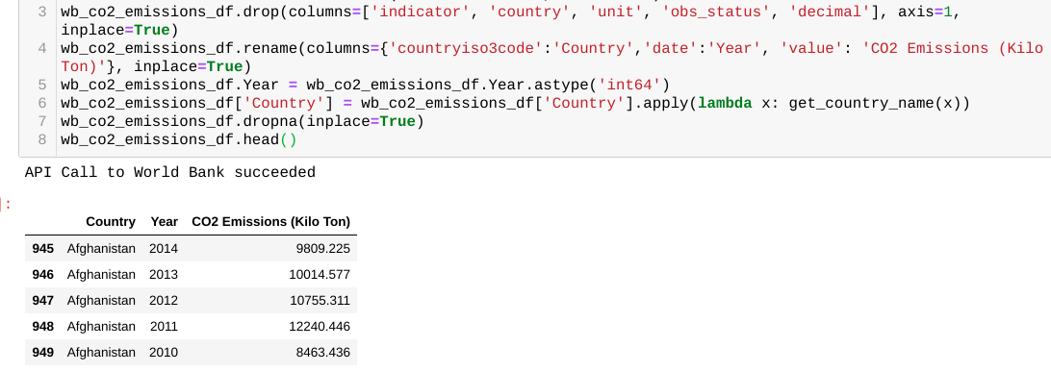
Data Cleanup & Exploration
Transformation
World Bank Total Greenhouse Gas Emissions
Kept only needed columns
Reformat year data type
Standardize country names
Notes:
WorldBank Total greenhouse gas emissions in kt of CO2 equivalent are composed of CO2 totals excluding short-cycle biomass burning (such as agricultural waste burning and Savannah burning) but including other biomass burning (such as forest fires, post-burn decay, peat fires and decay of drained peatlands), all anthropogenic CH4 sources, N2O sources and F-gases (HFCs, PFCs and SF6).
IMF API Government Finance Statistics (GFS), Expenditure by Function of Government (COFOG)

Slide 34
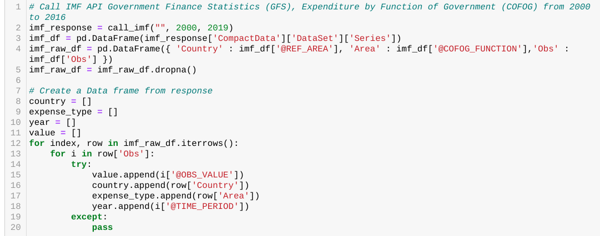
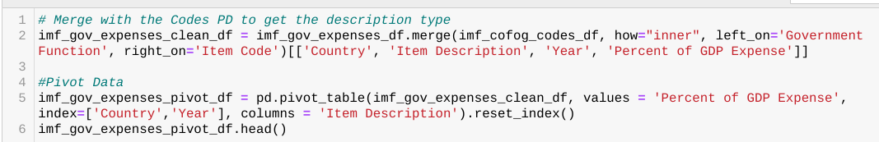
Data Cleanup & Exploration
Transformation
IMF API Government Finance Statistics (GFS), Expenditure by Function of Government (COFOG)
Notes:
WorldBank Total greenhouse gas emissions in kt of CO2 equivalent are composed of CO2 totals excluding short-cycle biomass burning (such as agricultural waste burning and Savannah burning) but including other biomass burning (such as forest fires, post-burn decay, peat fires and decay of drained peatlands), all anthropogenic CH4 sources, N2O sources and F-gases (HFCs, PFCs and SF6).
IMF API Government Finance Statistics (GFS), Expenditure by Function of Government (COFOG)

Slide 35
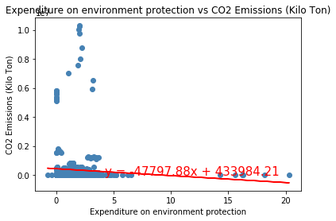
Data Analysis
Expenditure on environment protection
Plotting through Linear Regression shows that there is weak to no positive relationship at all between the two.
Notes:
First, we'll try to look at the most sensible link; the governments expenditure on environment protection.
We've included all years for all countries and made the x-axis (cause) as the expenditure, while CO2 emission is the effect. Our goal is to determine if there is a correlation on how much are the global governments spending on protecting the environment and the amount of Carbon Dioxide they produce. Plotting through Linear Regression shows that there is weak to no positive relationship at all between the two. The r-squared (absolute) is :0.06742692082833593

Slide 36
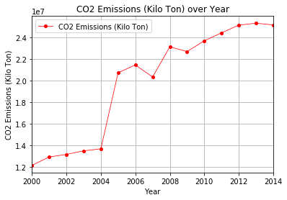
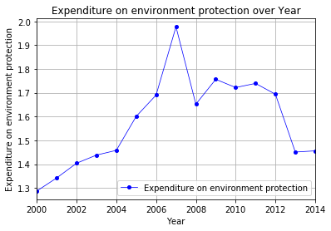
Data Analysis
Expenditure on environment protection (cont’d)
Based from the graphs, it can be deduced that the lesser the world governments' spend on climate change, the more the global emissions countries' generate.
Notes:
We've grouped the DataFrame by year, to calculate the total annual Global Carbon Dioxide Emissions, and the total average percentage spending of all countries. Based from the graphs, it can be deduced that the lesser the world governments' spend on climate change, the more the global emmissions countries' generate.

Slide 37
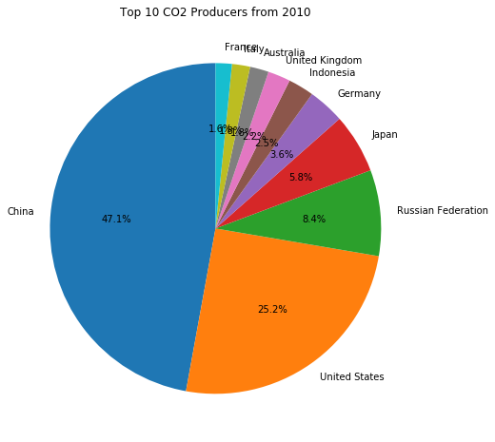
Data Analysis
Top 10 Emitters
After slicing the data frame to include only the top 10 CO2 producers, cumulative from year 2010 onwards, the pie chart below presents the world's largest Carbon Dioxide polluters.
Notes:
We were also interested in looking at the top 10 carbon dioxide emitter and found out that 9 out of 10 belong to the worlds top economies

Slide 38
Data Limitations
Data challenge was to pull and flatten the very complex IMF data (similar to World Bank) and dig into hundreds of indicators
Based from IMF, there is no consistent method of classifying environment protection expenses
Economic factor
Incomplete reporting on CO2 emissions (that's why there was no consistent choreography on the CO2 graph)

Slide 39

Gender
Is there a relationship between budget on social protection and gender inequality index?
Notes:
Elaborate on the questions you asked, describing what kinds of data you needed to answer them, and where you found it - note your data sources after your questions

Slide 40
Gender
Is there a relationship between budget on social protection and gender inequality index?
Notes:
Elaborate on the questions you asked, describing what kinds of data you needed to answer them, and where you found it - note your data sources after your questions

Slide 41
Data Cleanup & Exploration
Sources and method:
United Nations Development Programme Human Development Report, Gender Inequality Index
CSV
IMF API Government Finance Statistics (GFS), Expenditure by Function of Government (COFOG)
API, no authentication
Notes:
WorldBank Total greenhouse gas emissions in kt of CO2 equivalent are composed of CO2 totals excluding short-cycle biomass burning (such as agricultural waste burning and Savannah burning) but including other biomass burning (such as forest fires, post-burn decay, peat fires and decay of drained peatlands), all anthropogenic CH4 sources, N2O sources and F-gases (HFCs, PFCs and SF6).
IMF API Government Finance Statistics (GFS), Expenditure by Function of Government (COFOG)

Slide 42
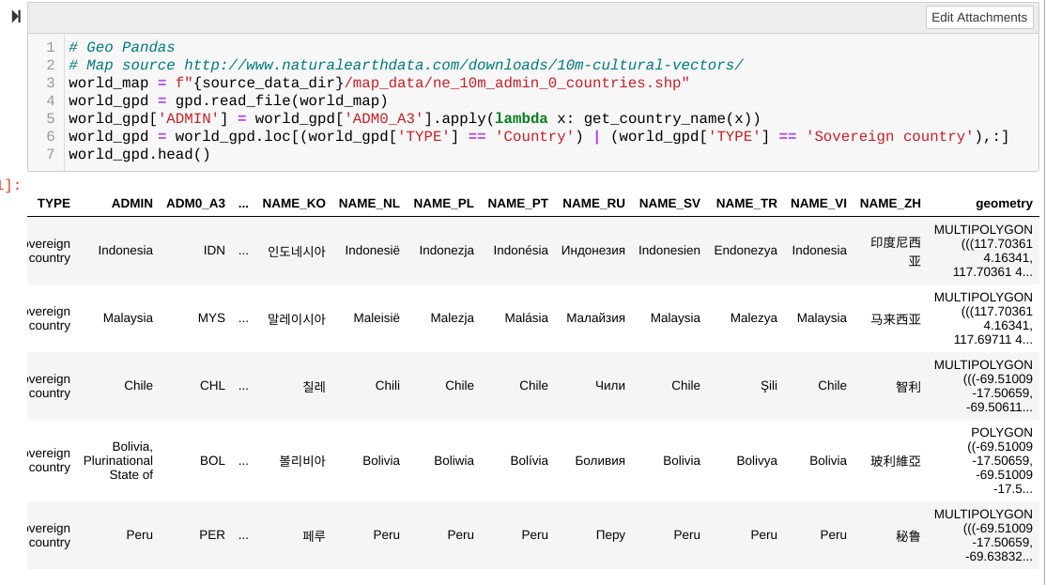
Data Cleanup & Exploration
Sources and method:
Natural Earth Data
Map/Geometry Data used for mapping via GeoPandas
Countries distinguish between metropolitan (homeland) and independent and semi-independent portions of sovereign states.
Notes:
WorldBank Total greenhouse gas emissions in kt of CO2 equivalent are composed of CO2 totals excluding short-cycle biomass burning (such as agricultural waste burning and Savannah burning) but including other biomass burning (such as forest fires, post-burn decay, peat fires and decay of drained peatlands), all anthropogenic CH4 sources, N2O sources and F-gases (HFCs, PFCs and SF6).
IMF API Government Finance Statistics (GFS), Expenditure by Function of Government (COFOG)

Slide 43
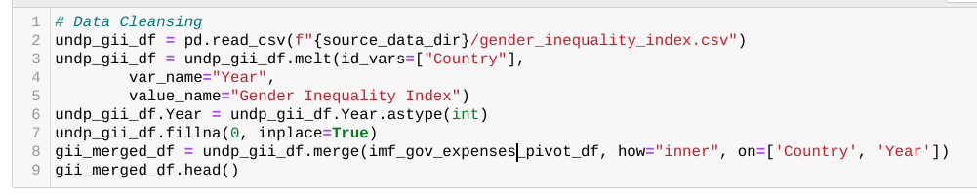
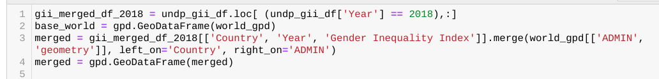
Data Cleanup & Exploration
Transformation:
United Nations Development Programme Human Development Report, Gender Inequality Index
Dataframe melting
Year casting
Nulls removal
Natural Earth Data
Merge with IMF Data
Standardize Country names
Notes:
WorldBank Total greenhouse gas emissions in kt of CO2 equivalent are composed of CO2 totals excluding short-cycle biomass burning (such as agricultural waste burning and Savannah burning) but including other biomass burning (such as forest fires, post-burn decay, peat fires and decay of drained peatlands), all anthropogenic CH4 sources, N2O sources and F-gases (HFCs, PFCs and SF6).
IMF API Government Finance Statistics (GFS), Expenditure by Function of Government (COFOG)

Slide 44
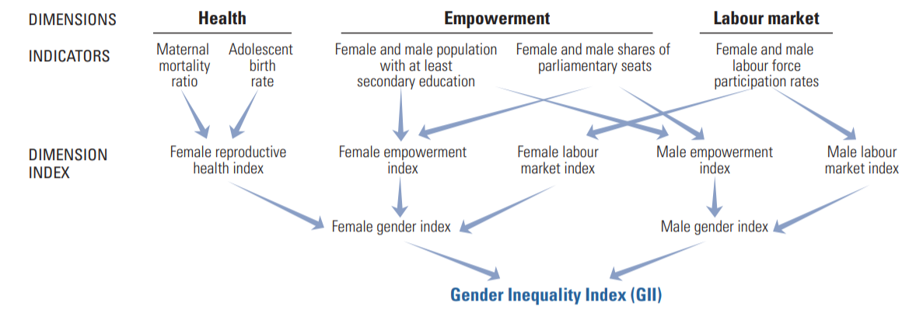
Data Analysis
Quick glance at how GII is calculated
Notes:
Discuss how advanced countries have higher gender equality compared to developing countries

Slide 45
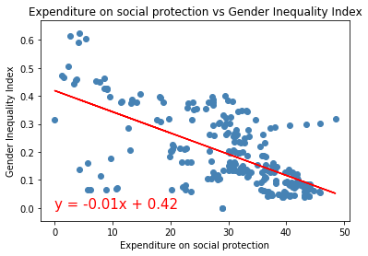
Data Analysis
Expenditure on social protection
Plotting through Linear Regression shows that there is a strong negative correlation between Gender Inequality Index and Social Protection Spending
Notes:
Talk about GII, factors affecting calculation. The lower the better.

Slide 46
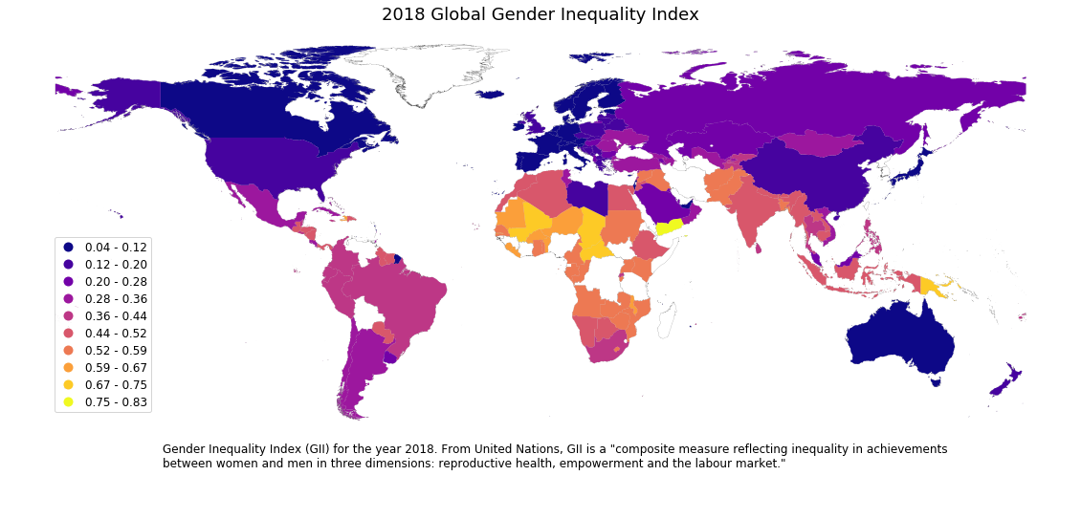
Data Analysis
A choropleth of GII using GeoPandas
Notes:
Discuss how advanced countries have higher gender equality compared to developing countries

Slide 47
Data Limitations
2018 was the only year that UN Development Program started to report a complete Gender Inequality Index calculation for all countries
Map takes time to render (crunch for geometry)
We have to remove Antarctica from the map, they are an outlier and have a lowest score of zero, having a perfect Gender Equality in the world (polar bears?)

Slide 48
Recap
Top priorities - Social Protection is the top priority of almost every country
Life Expectancy is linked to higher health spending
Safety ranking was negatively correlated with more spending
Students’ performance is directly linked to education budget
Environment spending does not necessarily mean governments’ produce less CO2
Social spending has a positive impact on Gender Equality!

Slide 49
Thank you!

